Slide 1
Sales Report
For A Oytra

Slide 2
Datasets used
The file contains all the meta information regarding the columns described in the Excel files. We have provided 2 tables :
Sales Summary Information
ItemID-SKU Mapping

Slide 3
Column Description for Sales Summary Information:
Invoice ID
Order ID
Item ID
Order Date
Supply City
Customer City
Product Name
Total Gross Bill Amount

Slide 4
Column Description for ItemID-SKU Mapping:
ItemId
SKU

Slide 5
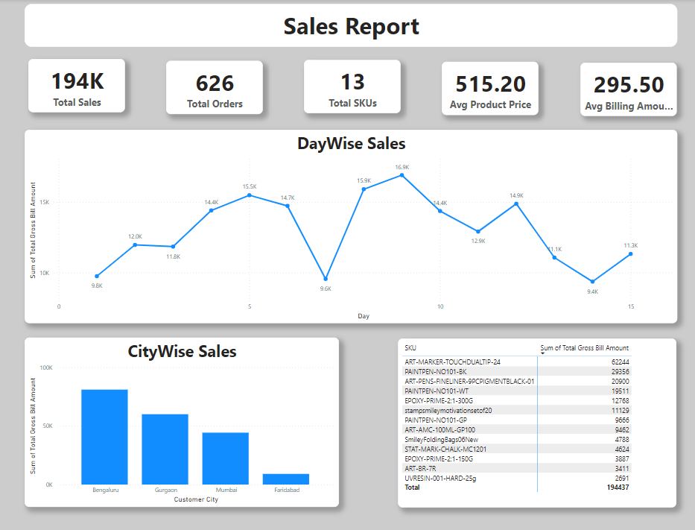
Sales dashboard

Slide 6
Dashboard insights
Total Sales- 194437 INR
Total Orders- 526 distinct orders
Total SKUs- 13
Highest Selling SKU- ART-MARKER-TOUCHDUALTIP-24
Avg Product Price- 515.20 INR
Avg Billing Amount- 295.50 INR
Highest Sales - 16901 (9 Jan 2025)
Lowest Sales- 9366(14 Jan 2025)

Slide 7
Reasons Behind Sales Fluctuations
There may be several reasons behind sales fluctuations,
Some of them are mentioned below:
Seasonal Demand
Market Competition
Limited Market Reach
Limited Consumer Awareness

Slide 8
Solution to address sales Fluctuations
Improve Brand Awareness
Analyse Customer Preference
Expand Sales Channels
Plan for Seasonal Demand
Adjust Pricing Strategies

Slide 9
THANK YOU
Rohan Kurade
rohankurade.1234@gmail.com

